Slide 1
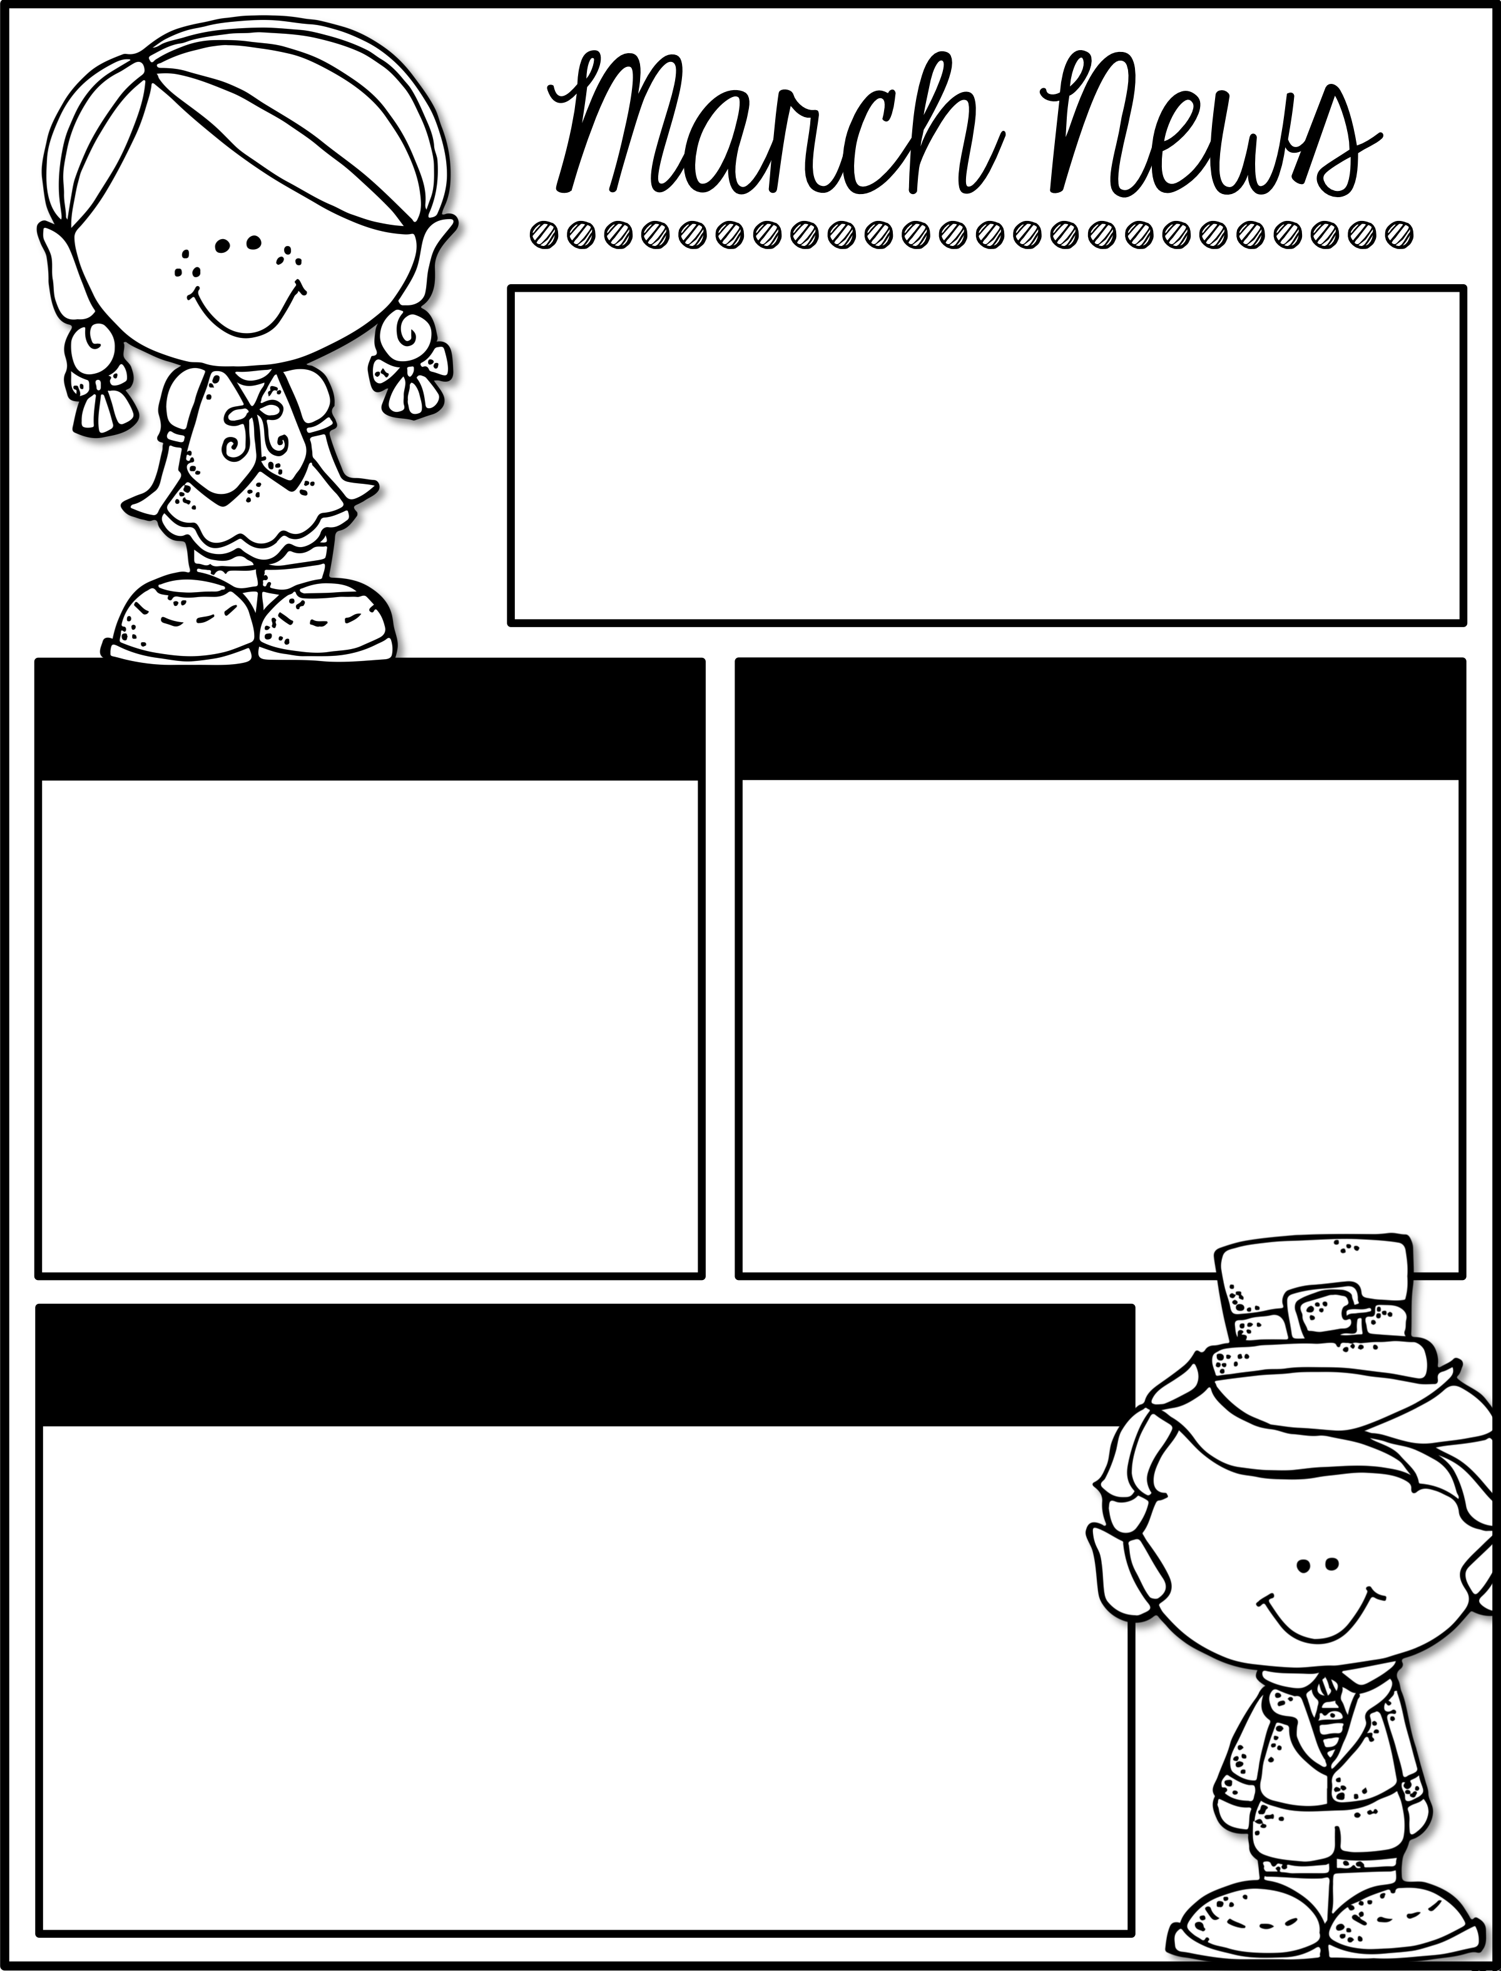
We struck GOLD
when you joined our class!
Events
Reminders
March 2nd - 6th– READ Across America Spirit Week
March 9th– No School
teacher workday
March 27th- Field Trip to
Marbles Kids Museum
April 1- 22nd - Track Out
Our class is running low on the following supplies. If you are able to send any in, it would be a huge help!
Thank you!
Clorox wipes
Tissues
Plastic utensils
Learning Focus
Literacy
Incorporating blends and digraphs into writing
Identifying features of non-fiction texts.
Science
Exploring weather and the impact is has on humans and their environment.
Math
Addition and subtraction with numbers up to 10.
Social Studies
How do jobs help people meet their wants and needs

